Slide 1
Opening an international restaurant in bratislava
A Prediction based on neighborhood clustering
Carlos Andres Pizarroso troncoso

Slide 2


motivation
Currently, our world is very globalized. $→$ People can go abroad without many difficulties compared with the past.
Exchange programs, studying abroad, work, leisure, etc.

Slide 3
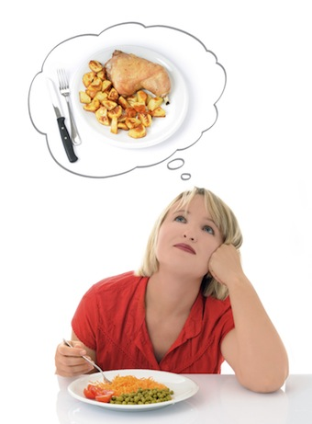

motivation
The longer a person is abroad, the more the person will miss some of their local food.
Personal experience. $→$ Where could I open an international restaurant in a foreign country?
What should I consider in order to open a restaurant abroad?
Potential Solution: Machine Learning (Neighborhood Clustering)

Slide 4
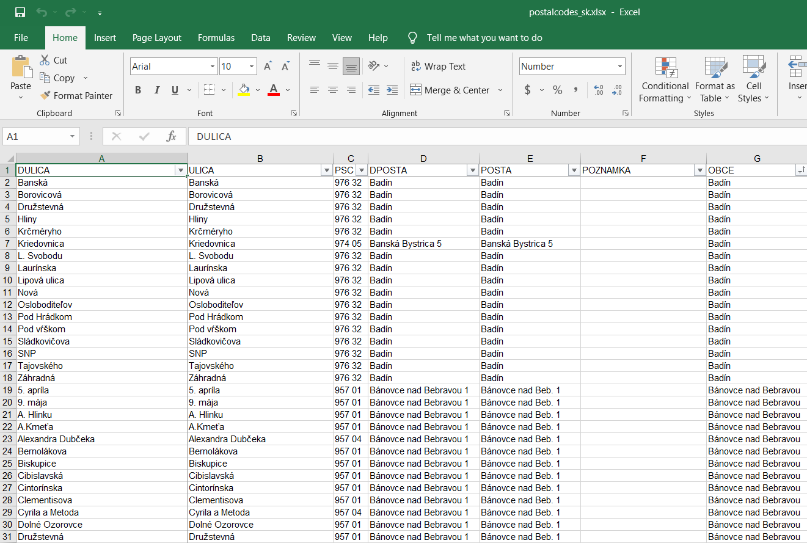
Source of data
Slovak Post official website.
Reliable internet sources.
Personally built.
All datasets are Microsoft Excel files which could be easily readable by Jupyter Notebook.

Slide 5
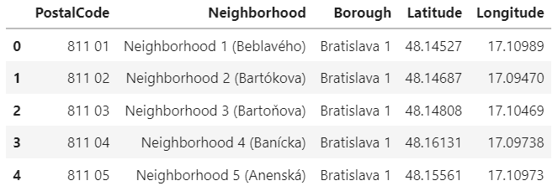
Data cleaning
Dropping irrelevant columns: ‘DULICA’, ‘DPOSTA’ and ‘POZNAMKA’.
Renaming Columns.
Eliminating rows with empty values.
Reducing columns from 10547 to 56 by grouping streets with same Postal Code.
Adding geographical data (Latitude, Longitude)
Final Result:

Slide 6
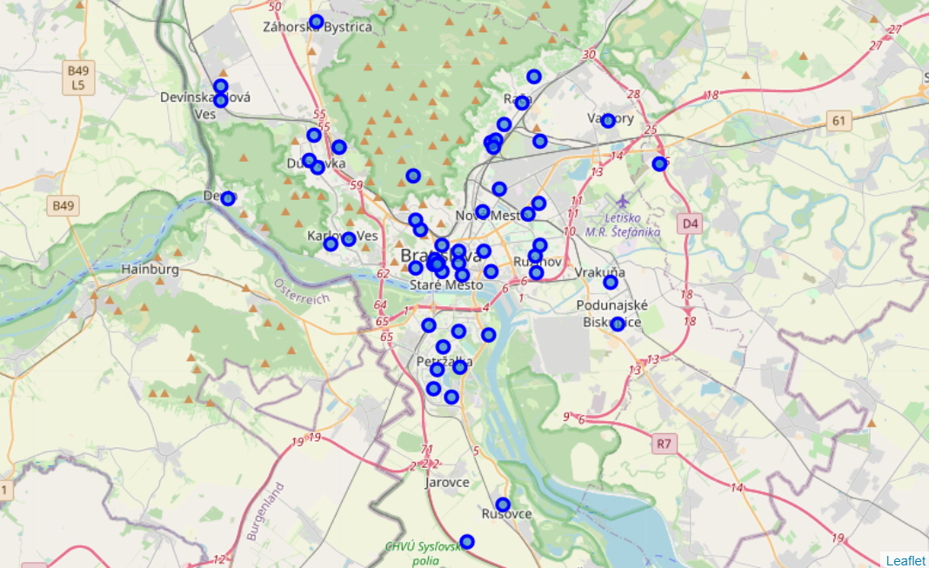
Data visualization
Visualization through Geopy and Folium maps.
56 Neighborhoods successfully plotted across Bratislava City.

Slide 7
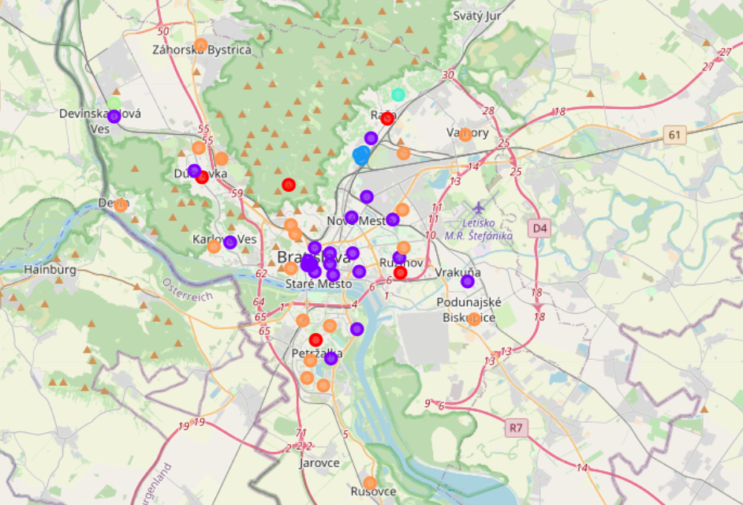

Machine learning analysis
Machine Learning method used: K – Means.
Optimal K found by Elbow Method.
K = 6 found as optimal $→$ 6 main clusters would be formed.
Different color for different cluster of neighborhoods.

Slide 8
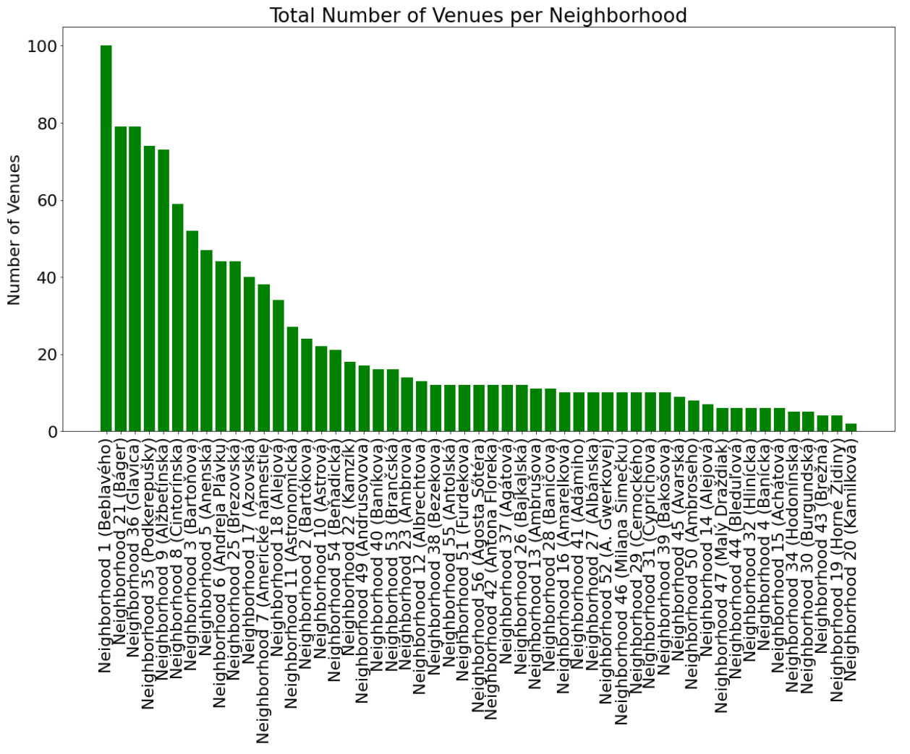
Total number of venues retrieved

Slide 9
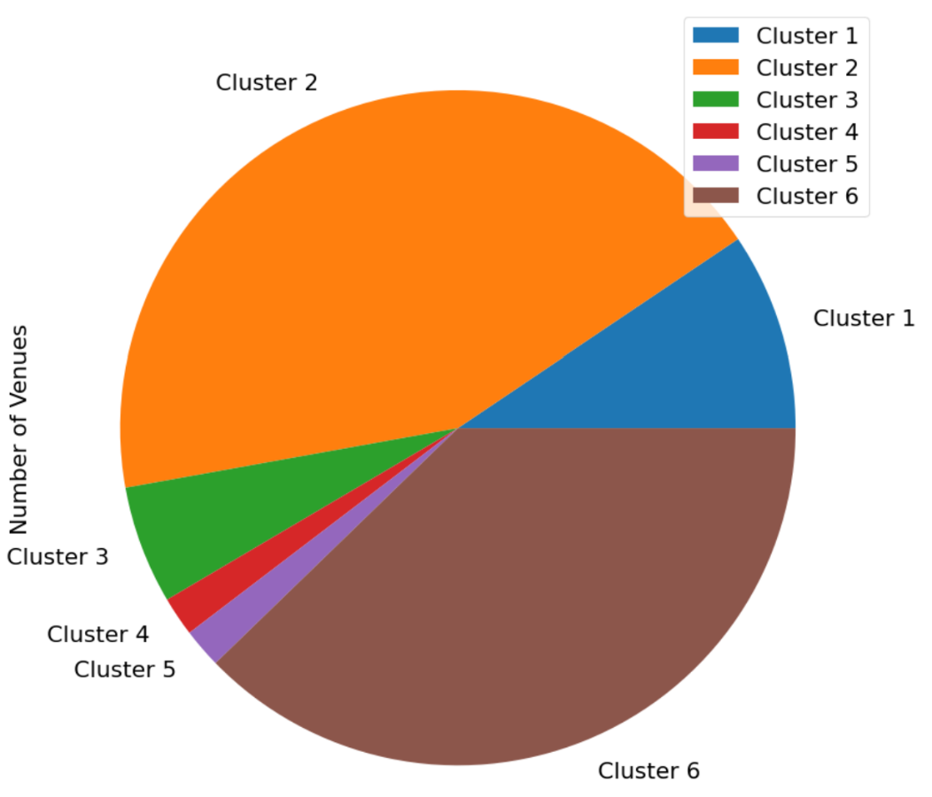
Proportion of venues in Bratislava

Slide 10
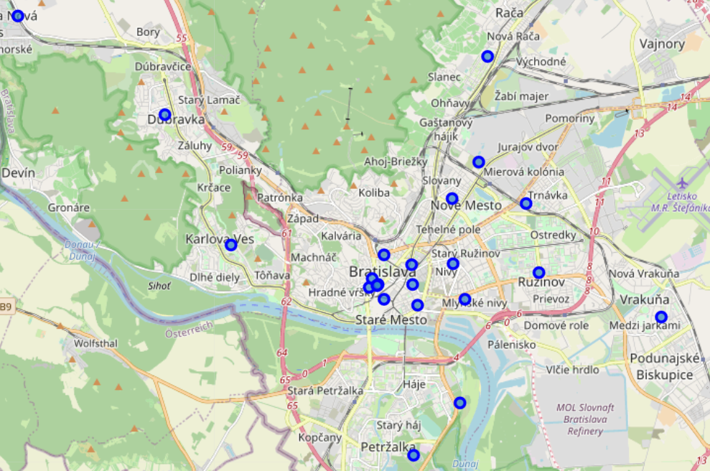
Cluster 2
Neighborhoods mostly located in the center of the city: Downtown and touristic places.

Slide 11
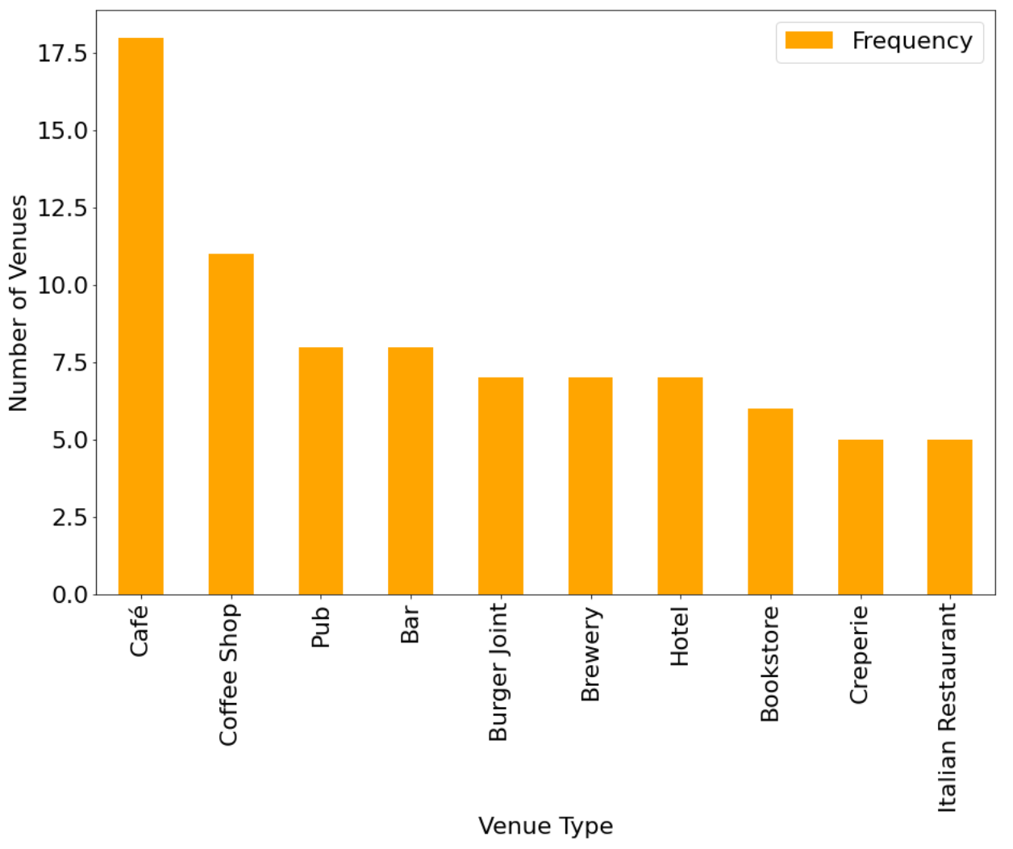
Cluster 2
Characteristic Venues of this cluster are Coffee Shops and casual dining places (Pubs, Bars and Burger Joints).
Potential clue about people influx.

Slide 12
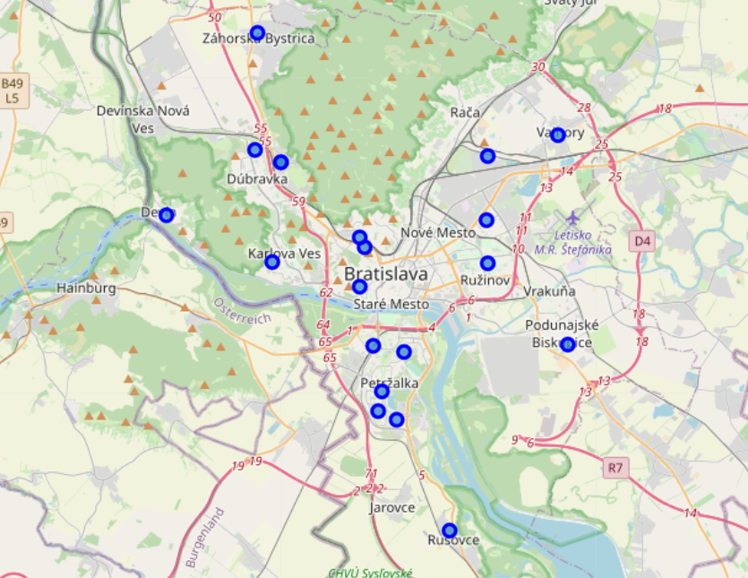
Cluster 6
Neighborhoods are located further away from each other.
Neighborhoods are located more in residential areas.
Prediction: Venues should be different from cluster 2.

Slide 13
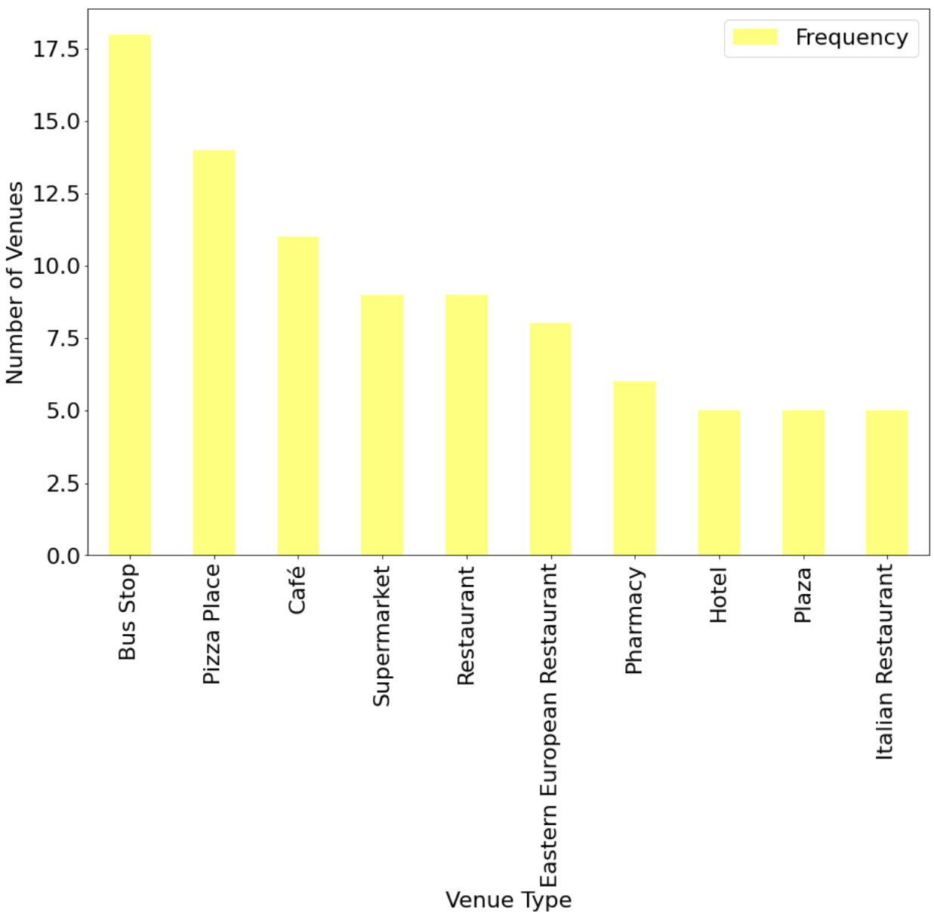
Cluster 6
Characteristic venues of this cluster are: Bus stops, restaurants (Pizza places, local restaurants and Italian restaurants) and grocery shops (Supermarkets, Pharmacies and Plazas).
Eventually, different from cluster 2.

Slide 14
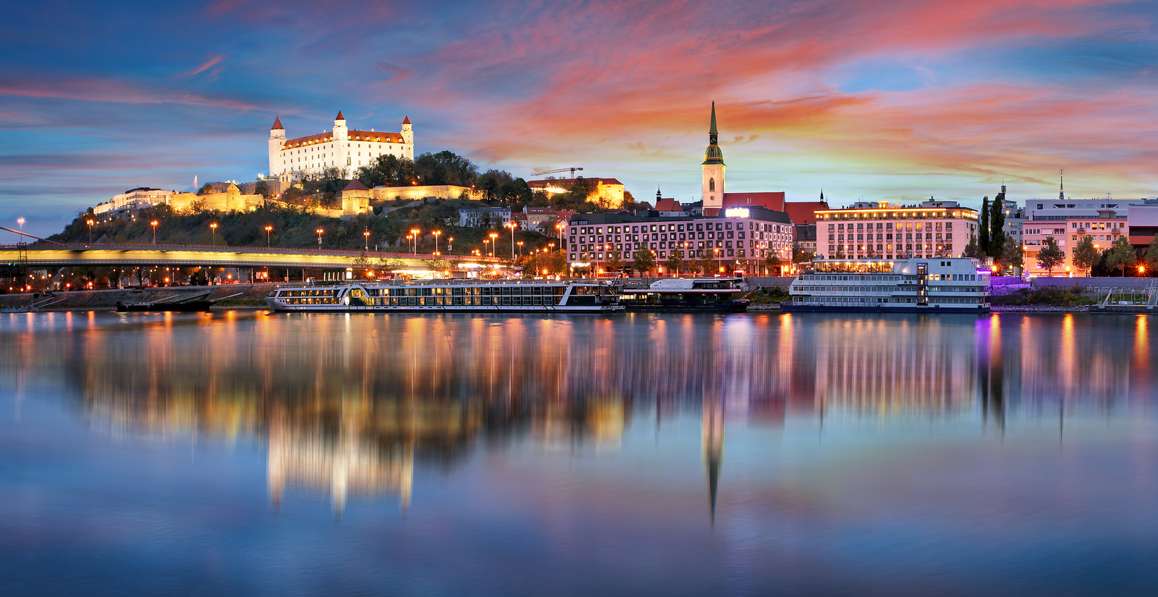
conclusion
A neighborhood which belongs to Cluster 2 and it is located in the center of Bratislava could be a potential candidate as an ideal place for opening a restaurant.
People tend to have a meal first before going to a coffee shop or pub – bar.
Influx of people.

Slide 15
References
https://www.posta.sk/sluzby/postove-smerovacie-cisla
https://www.postcodesdb.com/AlphabeticSearch.aspx?country=Slovakia&city=Bratislava
https://github.com/OpenDataSk/datasets/blob/master/postalcodecoordinates_sk.json

